Slide 1


Choosing the “best” tree Telco Churn Example
Wake Forest
School of Business
_______
BAN 6025

Slide 2
Telco Churn Case
A large telecommunications company is concerned because the percentage of customers who leave the company for another service provider is too high
They would like to identify customers who are likely to churn (switch wireless service providers) when their contract ends in order to develop a strategy for retaining valuable customers
A data dictionary is provided in the following slide

Slide 3
Variable Name | Description
State | State of Residence
Account Length | # Weeks customer has been with the company
Area Code | 3 digit area code
Phone | 7 digit phone number
Int’l Plan | Does the customer have an international plan? Yes/No
VMail Plan | Does the customer have a voicemail plan? Yes/No
Vmail Message | # Voice mail messages received per month
Day Mins | Daytime calling minutes used per month
Day Calls | Number of daytime calls per month
Day Charge | Daytime calling charges per month in USD
Eve Mins | Evening calling minutes used per month
Eve Calls | Number of evening calls per month
Eve Charge | Evening calling charges per month in USD
Night Mins | Nightime calling minutes used per month
Night Calls | Number of nighttime calls per month
Night Charge | Nightime calling charges per month in USD
Intl Mins | International calling minutes used per month
Intl Calls | Number of international calls per month
Intl Charge | International calling charges per month in USD
CustServ Calls | Number of customer service calls per month
Churn? | 1 if the customer switched providers, 0 otherwise

Slide 4
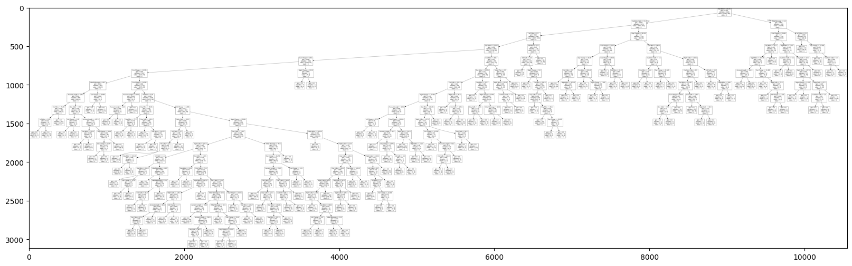
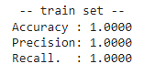
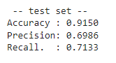
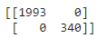
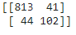
Fit a baseline decision tree using DecisionTreeClassifier Defaults

Slide 5
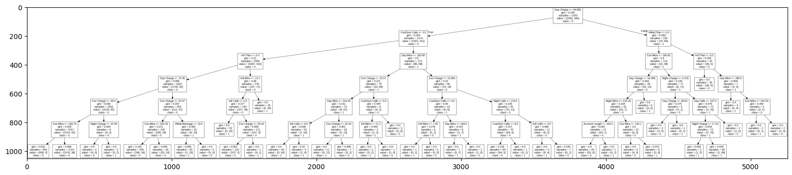
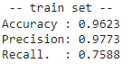
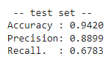
Change max_depth to 6

Slide 6
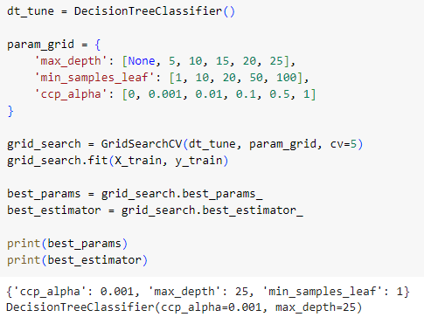
What are the “best” parameter settings?

Slide 7
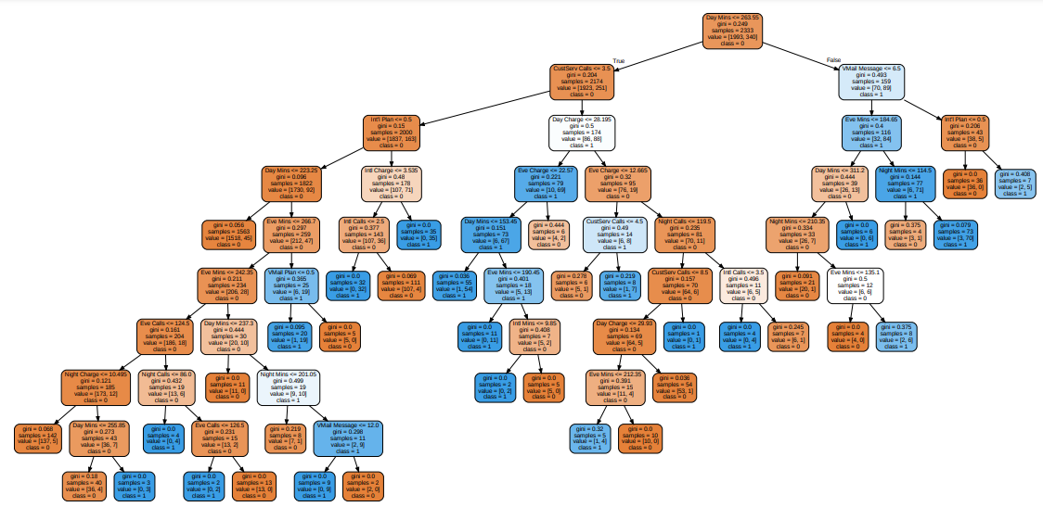
“Tuned” Tree

Slide 8
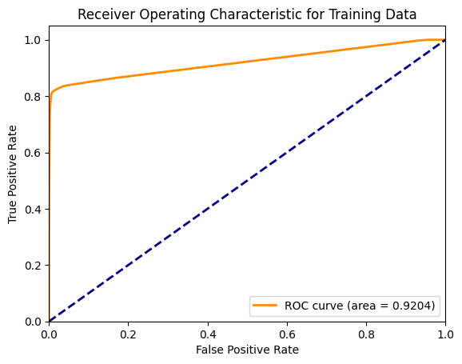
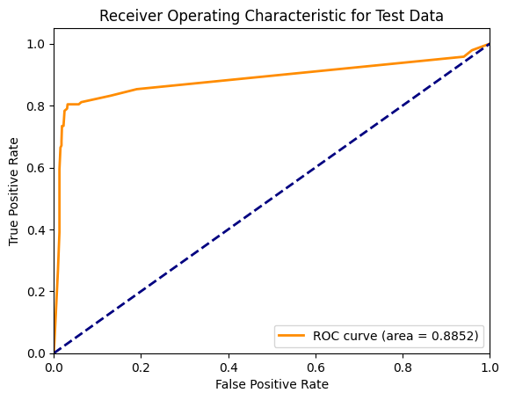
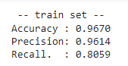
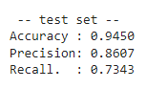
“Tuned” Tree

Slide 9
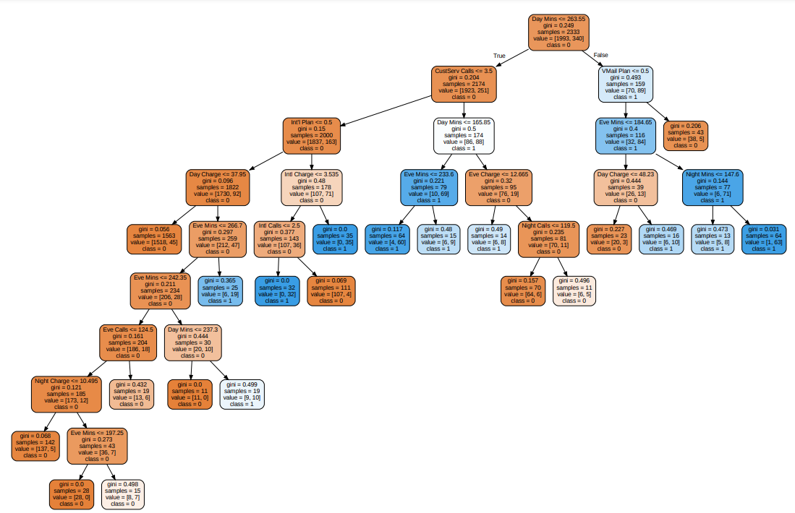
Increase min_samples_leaf=10

Slide 10
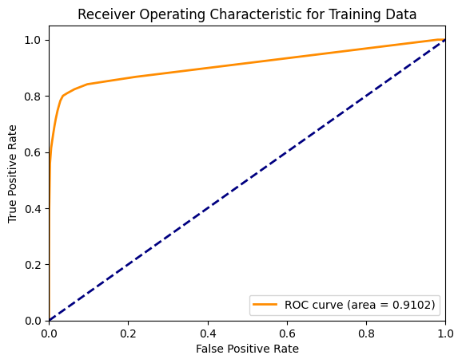
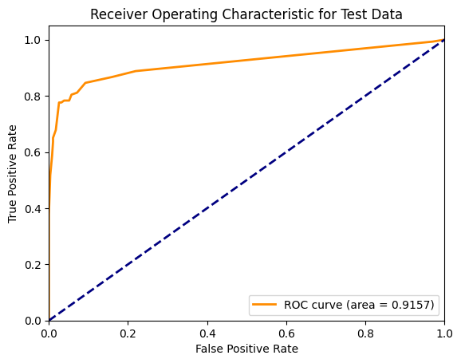
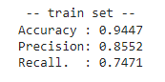
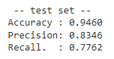
Assessment

Slide 11
Model Comparison
 | Accuracy (Train) | Precision (Train) | Recall (Train) | AUC (Train) | Accuracy (Test) | Precision (Test) | Recall (Test) | AUC (Test)
Default | 1 | 1 | 1 | 1 | 0.9220 | 0.7211 | 0.7413 | 0.8467
Tuned | 0.9670 | 0.9614 | 0.8059 | 0.9204 | 0.9450 | 0.8607 | 0.7343 | 0.8852
Min Samples 10 | 0.9447 | 0.8552 | 0.7471 | 0.9102 | 0.9460 | 0.8346 | 0.7762 | 0.9157

Slide 12


Interpretation (Final Model)

